Slide 1
WD India –Process Flow

Slide 2
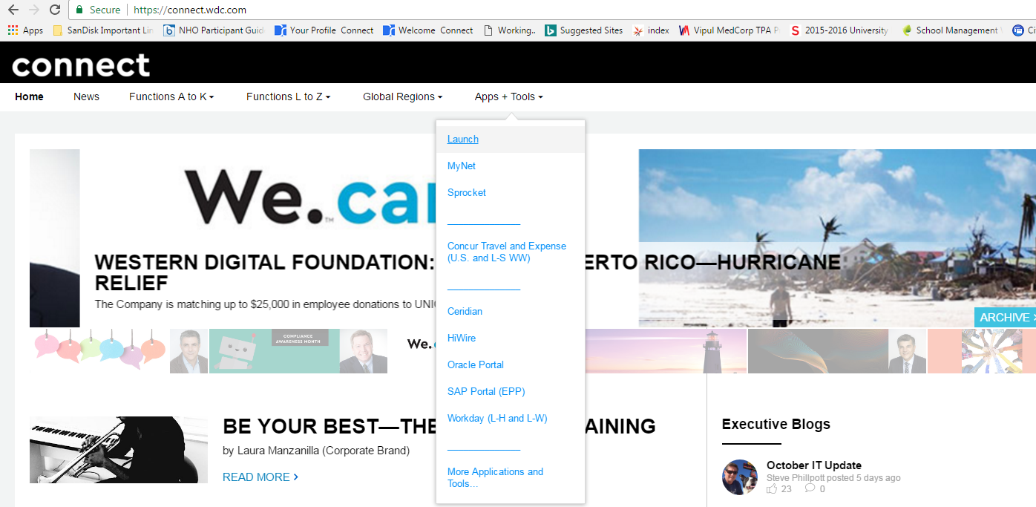

Leave Process

Slide 3
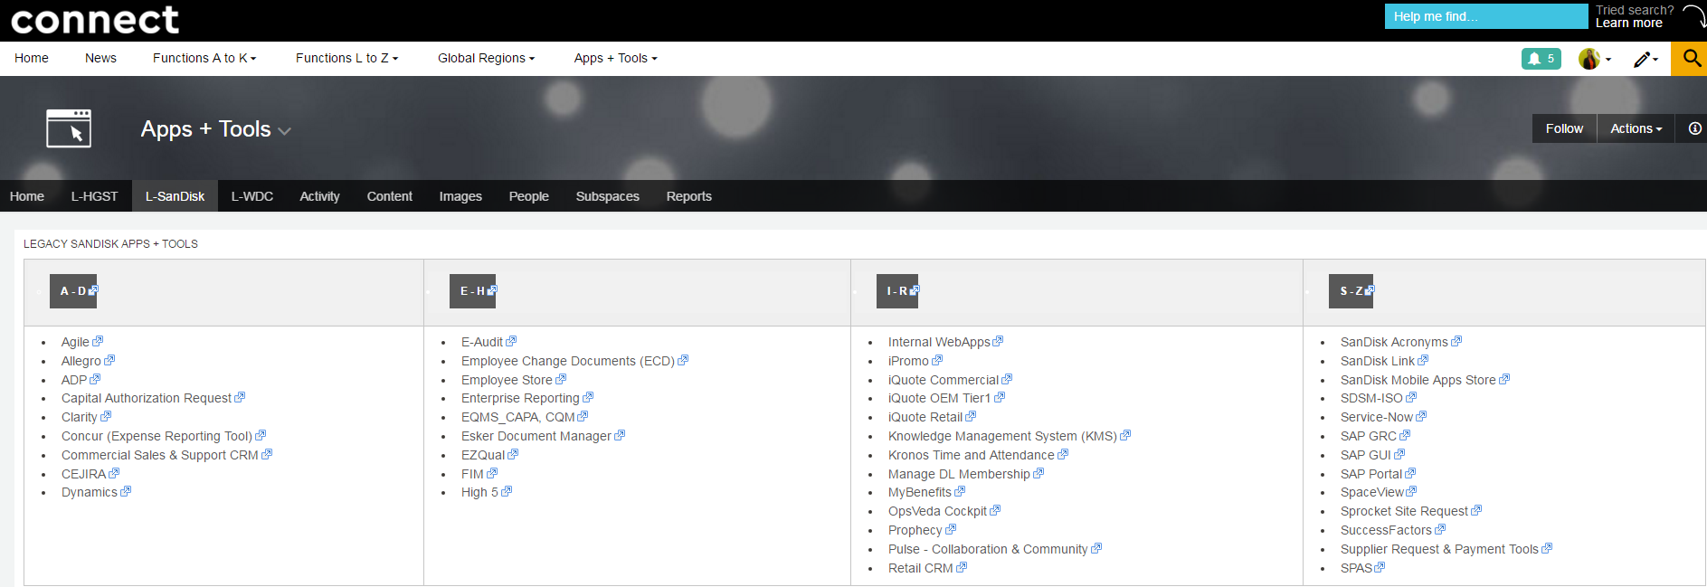

Leave Process
User ID:EE ID

Slide 4
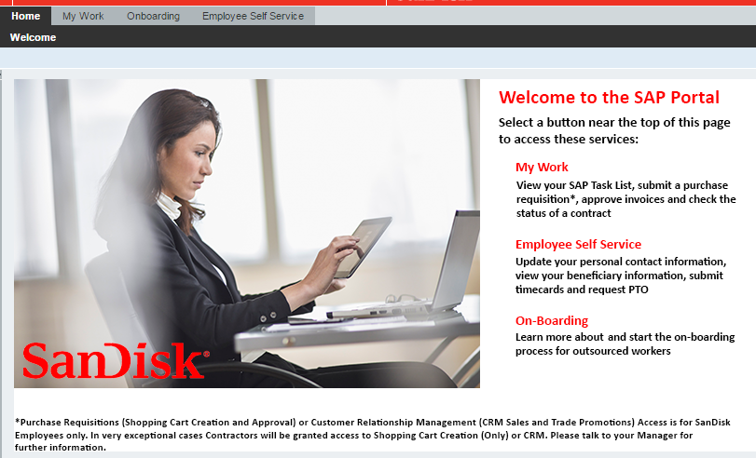
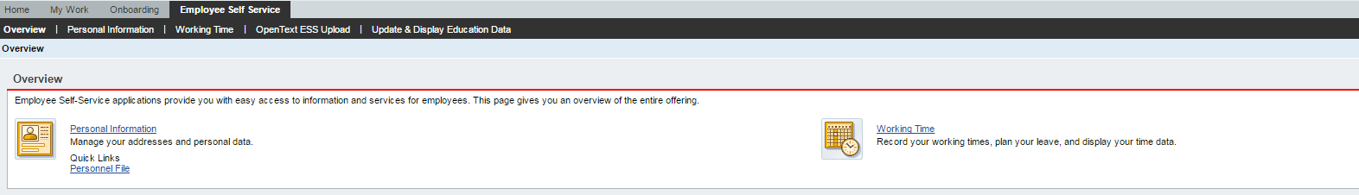
Leave Process
Click on Employee self service

Slide 5
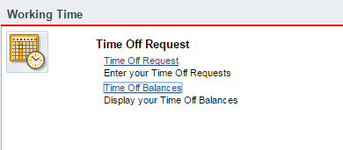
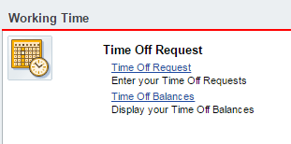
Leave Process
Click: Time Off Balance to check balance
Click: Time Off Request to apply leave

Slide 6



